Slide 1
Copernicus Climate Change Service
K4I Forum Dinner Debate
5 March 2019
André Obregón, ECMWF

Slide 2
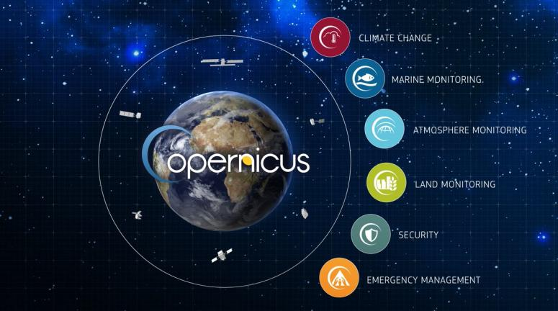
Copernicus: Earth observations and information services

Slide 3
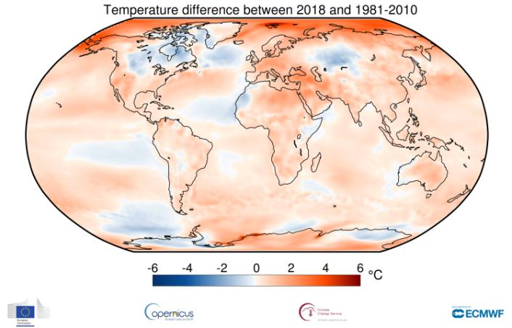
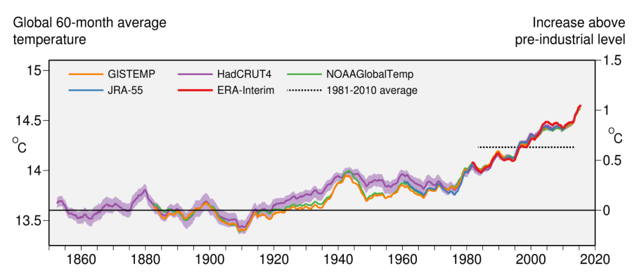
State of the Climate

Slide 4
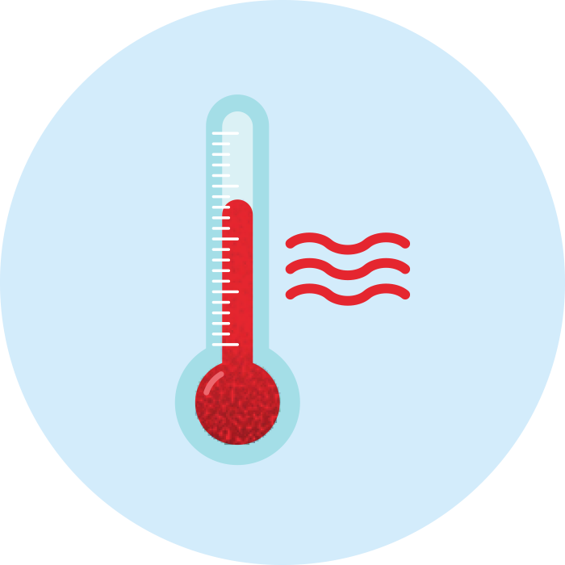
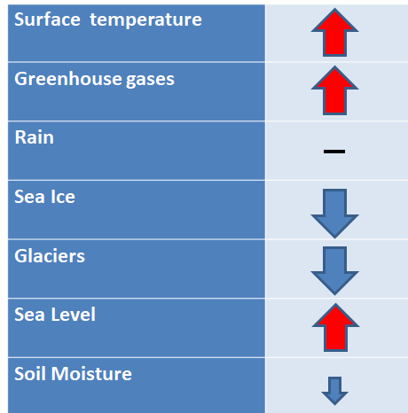

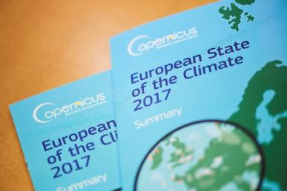



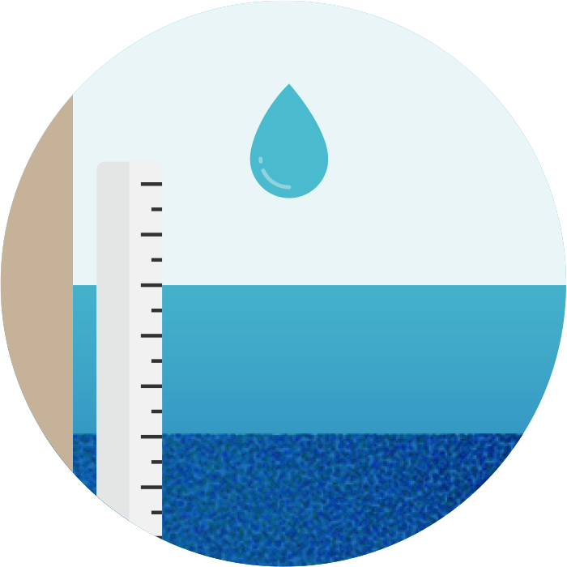

Climate indicators
climate.copernicus.eu/CopernicusESC

Slide 5
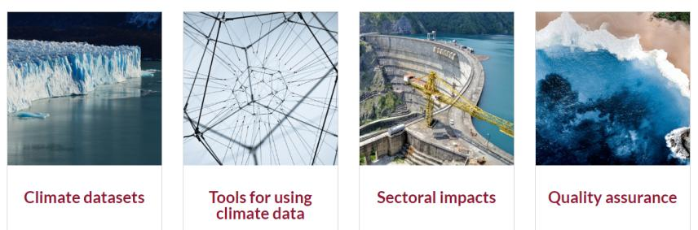
Copernicus Climate Change Service

Slide 6
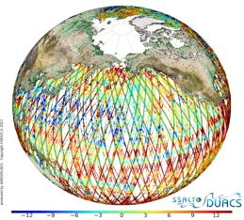
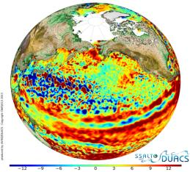
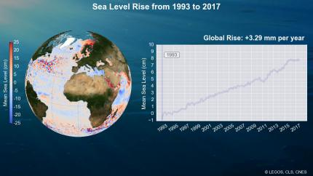
From satellite tracks to long-term global coverage
From satellite along-track measurements…
… to sea level gridded maps…
… to derive Ocean Monitoring Indicators

Slide 7
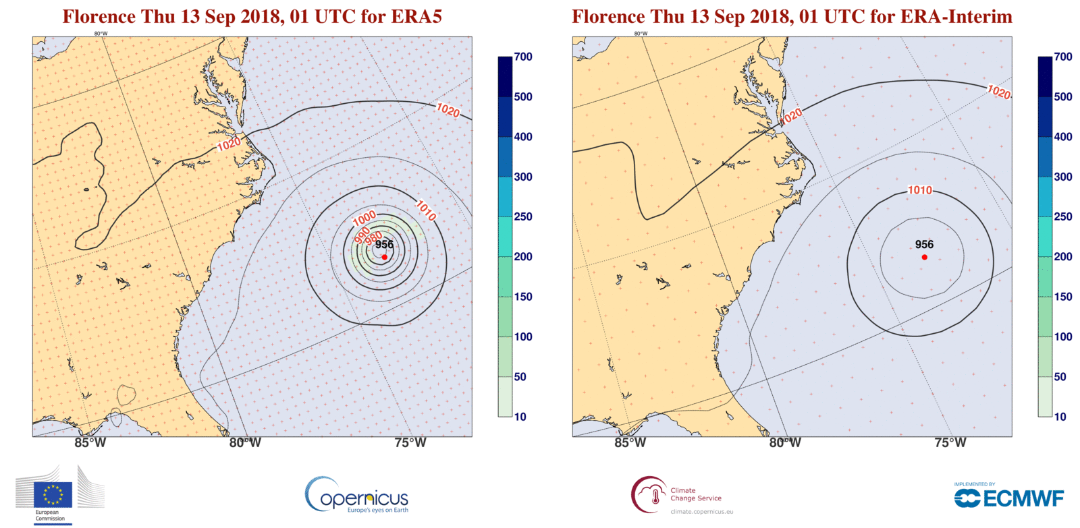
Climate Reanalysis: Going from ERA-Interim to ERA5

Slide 8

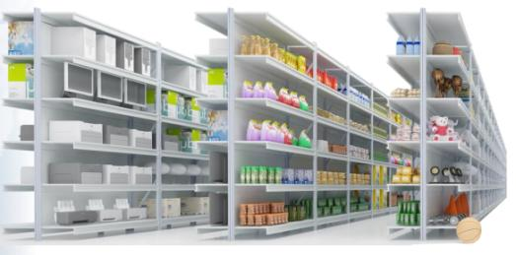
Building a Climate Data Store
Putting the products on the shelves...

Slide 9


Evaluation and Quality Control
Quality of data:
assessments
user guidance
gaps and limitations
Quality of tools:
fitness for purpose
best practices
Quality of service:
speed, responsiveness
system availability, …

Slide 10
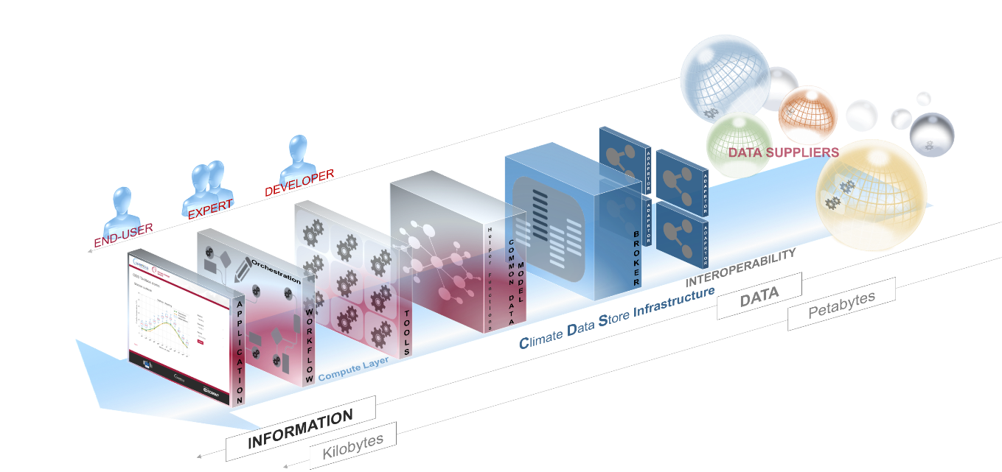
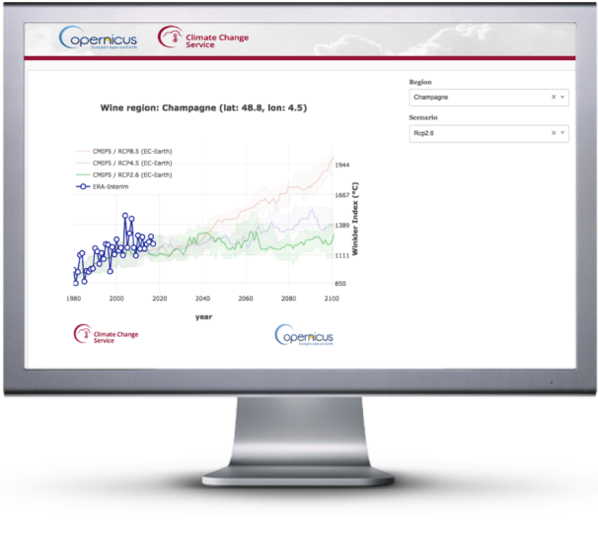
Climate Data Store
Service chain

Slide 11
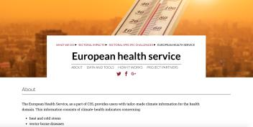
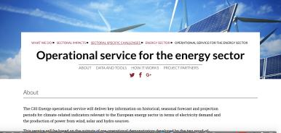
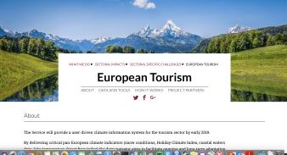
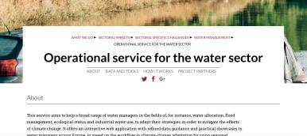
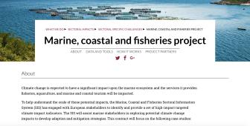
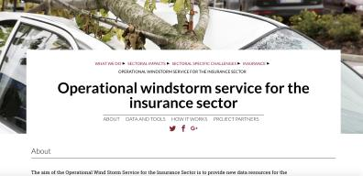
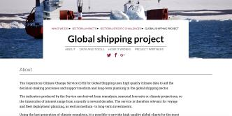

Sectoral Information Systems

Slide 12
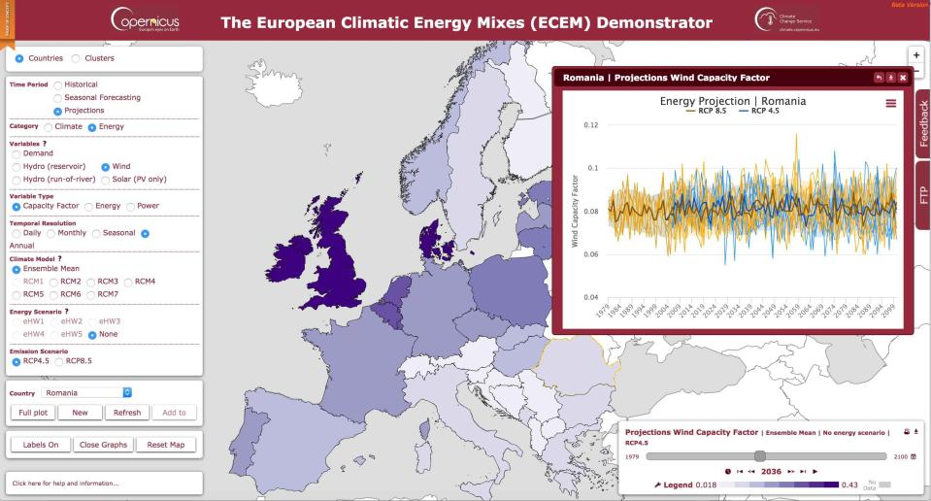







http://ecem.wemcouncil.org
Notes:
The C3S ECEM Demonstrator:
An online interactive tool to test energy mixes

Slide 13
Thank you
André OBREGÓN
Tel: (+44) 118 949 9028
Email: andre.obregon@ecmwf.int
https://climate.copernicus.eu/
http://copernicus.eu/

