Slide 1
Robust measurements of climate change
Emma Woolliams
European Metrology Network for Climate and Ocean Observation

Slide 2
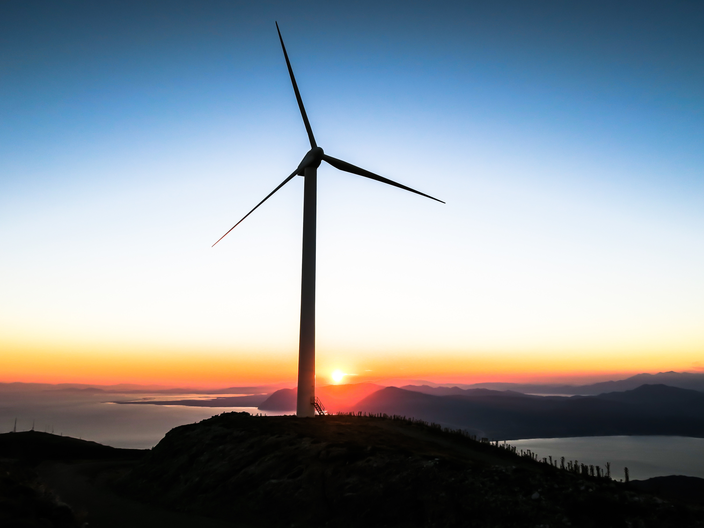
Photo by Jason Blackeye on Unsplash

Slide 3
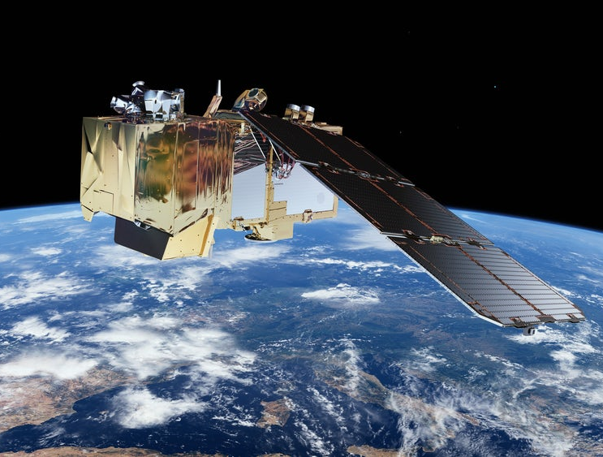
Image of Sentinel-2 by ESA

Slide 4
Photo by Chromatograph on Unsplash

Slide 5
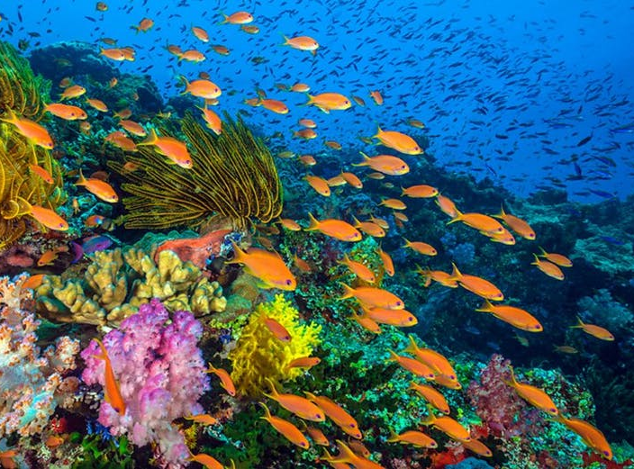
Photo from BBC Living Planet

Slide 6
Robust measurements of climate change
European Metrology Network for Climate and Ocean Observation
Contact:
Emma.Woolliams@npl.co.uk

