Slide 1
SUpport and PartnERship for the development of multiple sustainable and market ready value chains in the BIO-based economy
SuperBIO is funded by the research and innovation programme ‘Horizon 2020’ of the European Union under the Grant Agreement no. 691555 for the period from 01.06.2016 to 30.11.2018

Slide 2
Innosup (H2020): Cluster facilitated projects for new industrial value chains
Biobased economy
High potential for new value chains
Cross sectoral
About 20 sectors involved
Cross border

Slide 3
60 applications, 49 ideas validated
42 value chains created linking feedstock providers, technologies and end-users
37 companies received services from SuperBIO’s renowned service providers
Stakeholders from 19 EU countries involved
42 applicants were introduced to 87 companies leading to a network of 120 companies
37 new technologies, processes or products

Slide 4
7 new food ingredients and 2 new feed ingredients
7 new agrochemicals developed
4 new processes to convert food waste
8 new biobased chemicals
5 new biobased materials developed
21 processes developed, optimised or scaled up

Slide 5
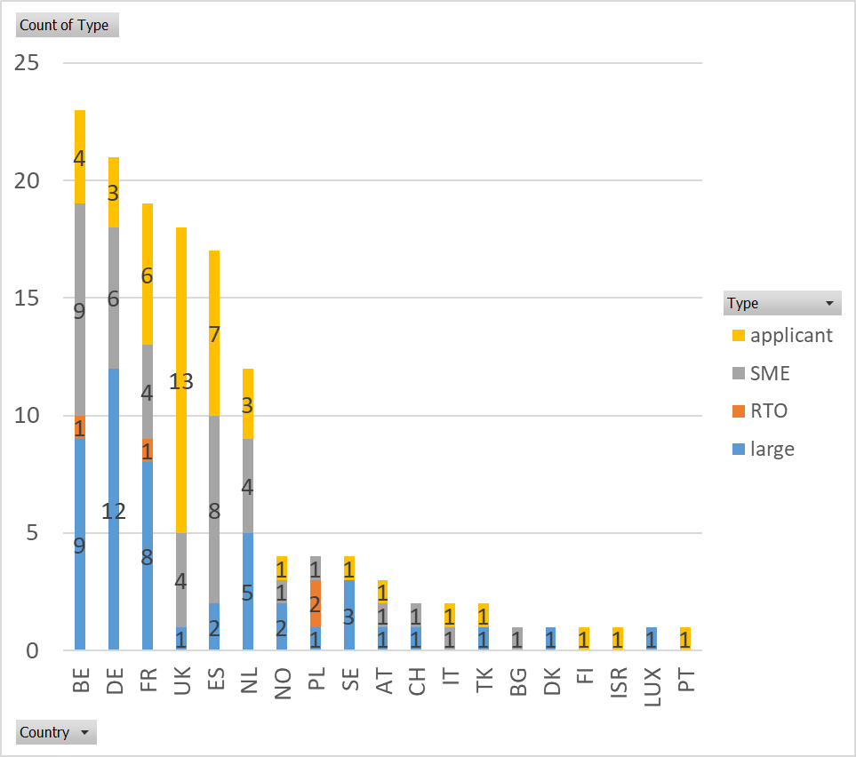
High level overview of SuperBIO

Slide 6
Thank you!
Stefan.ruyters@fbbv.be, Flanders Biobased Valley
SuperBIO is funded by the research and innovation programme ‘Horizon 2020’ of the European Union under the Grant Agreement no. 691555 for the period from 01.06.2016 to 30.11.2018

