Slide 1
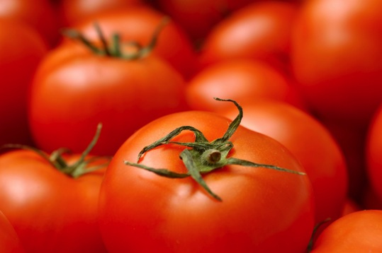
AGROBODY™
The Next Generation Biopesticides
Not for distribution

Slide 2
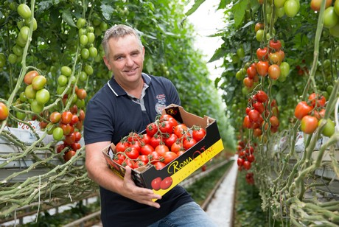
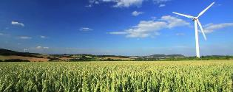
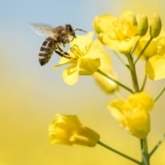
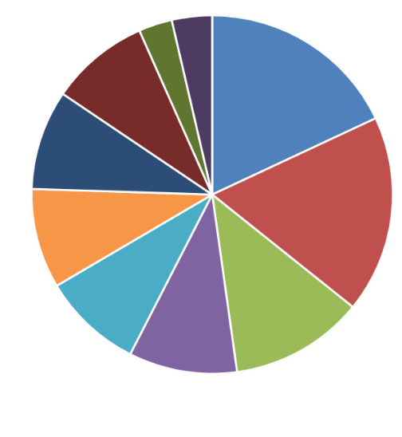
Company Profile
Our Mission
Reliable biopesticides – compatible with IPM practices
Healthier food, no residues
Transform crop protection from chemical to bio-based
Shareholders’ Structure
6 Private Shareholders
K&E, BVBA
3.6%
3%
18.0%
8.9%
9.0%
Incorporated in 2013
Private, Venture Capital-backed
International Board and Investors
Growth from 23 to 31 FTEs in 2018
Madeli Participaties, BV
17.8%
Biovest, CVA
9.0%
9.0%
12.0%
9.7%
IPM: Integrated Pest Management program
Not for distribution

Slide 3
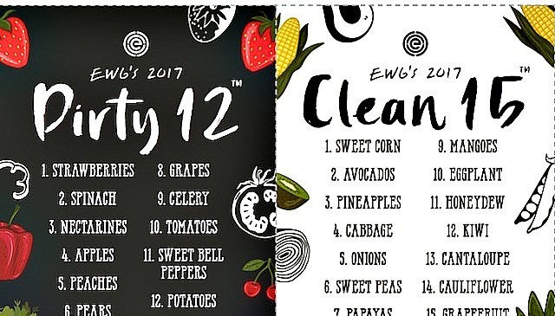
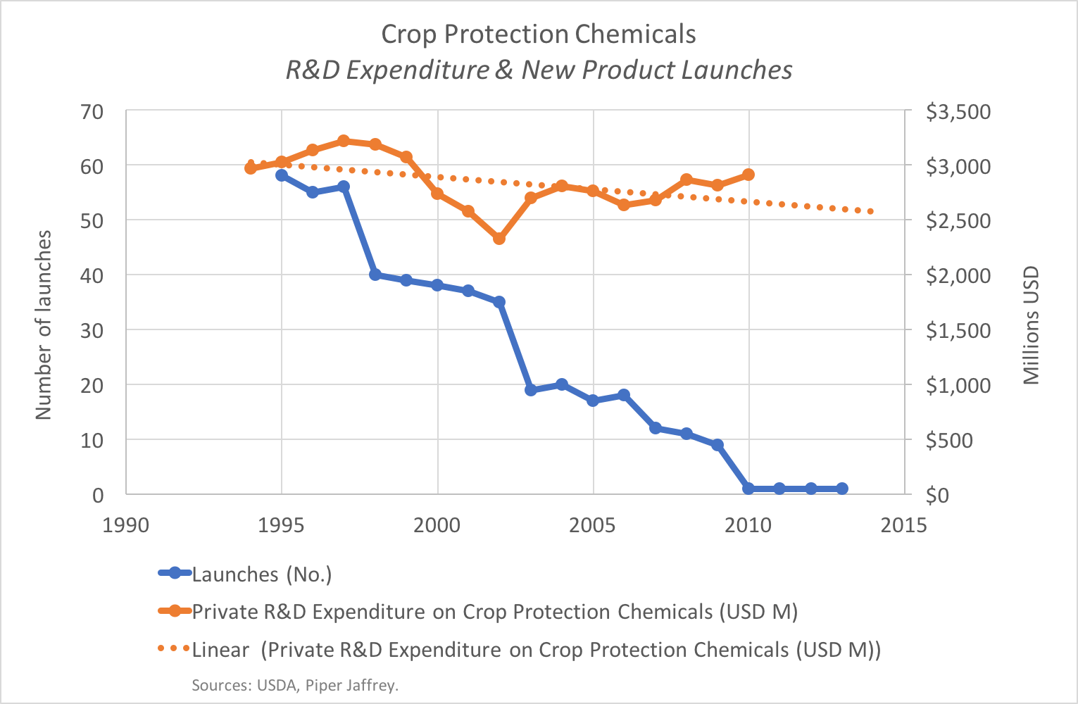
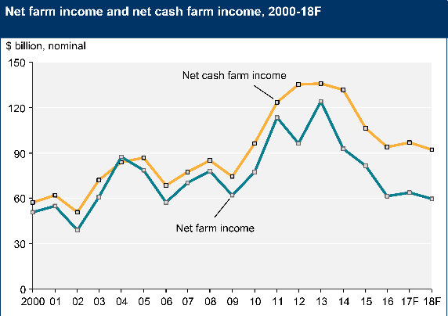
Pressing challenges in Ag
Informed consumers impact the food chain
Healthy food, chemically residue free
Aware of the impact of Agriculture on the environment
AgIndustry needs urgently new Crop Protection products
Regulatory pressure drives existing AI’s from the market
Pipeline drying up, despite high R&D investment
Long R&D timelines, uncertain regulatory landscape
Slower sales growth of major CP companies
Farmers faced with lower income, higher concerns
Need novel modes of action to tackle resistance issues
Current (biological) alternatives are not good enough
Societal pressure on residue and environmental impact of Ag
Sources: EWG: Environmental Working Group
https://agfundernews.com/crop-protection-biologicals-vs-chemicals.html
Piper Jaffray Investment Bank
USAD - 2018 Farm Sector Income Forecast – Febr. 7, 2018
3
Not for distribution
CP companies: Crop Protection Companies
AI’s: Active Ingredients
Notes:
3

Slide 4
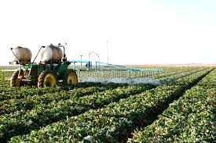
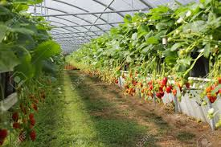
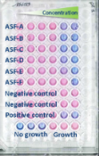
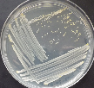
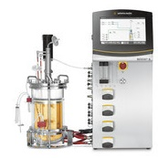
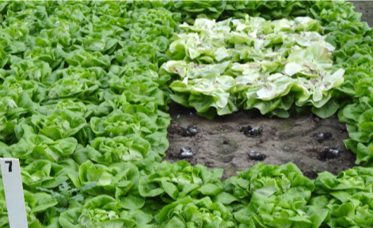
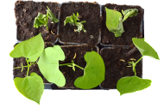
The solution: AGROBODY™ biopesticides
From target selection to development …
Selected fragments of the antibodies
= AGROBODY™
Biopesticides
Camelid
antibodies
Target identification
Immunization
Technology platform validated in healthcare!
Optimization for performance and manufacturing
Commercialization
Registration
Development
Evaluation
… to manufacturing and commercialization
At cost parity for the farmer!!
4
Not for distribution

Slide 5
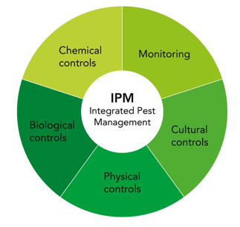
Primary target: Fruit & Vegetable segment
Solving farmers’ challenges to maximize yield of high quality, residue free fruits
Providing novel mode of action, solution within an integrated resistance management program
Providing high efficacy levels, consistent performance to:
Conventional farmers
Organic / Bio farmers
Only solution to safeguard high yield, high quality at or close to harvest
AGROBODY™ biopesticides replace chemical pesticides in an IPM program
IPM: Integrated Pest Management
PHI: pre-harvest interval
REI: re-entry interval
Not for distribution
5
Notes:
5

Slide 6
Towards bio-cultivation of grapes
Grapes disease protection 26 days post treatment (Botrytis cinerea)
AGROBODY™ biofungicide reduces grape infection substantially vs chemical treatment alone
No phytotoxicity observed in field and greenhouse trials
EU/US grape market over € 1bn Fungicides: € 740m
Percent Diseased Bunches
ab
bc
bc
d
AGROBODY™
biofungicide
Result from one-to-one pure product comparison – no IPM spray program applied
Source: AgroSavfe trials 2017
Not for distribution
6
Notes:
6

Slide 7
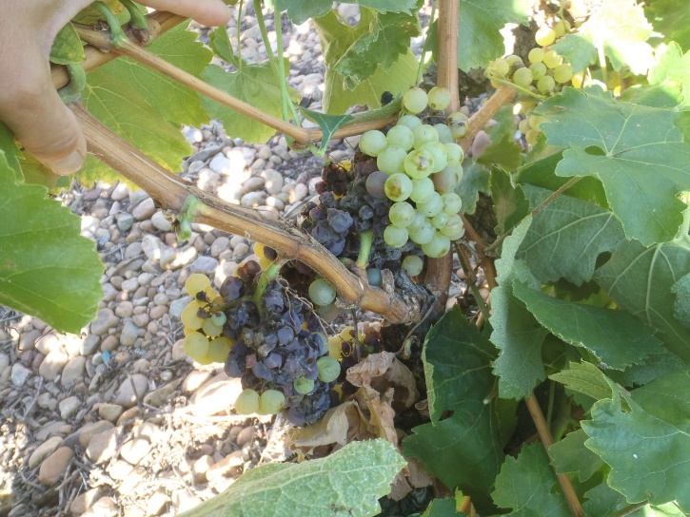
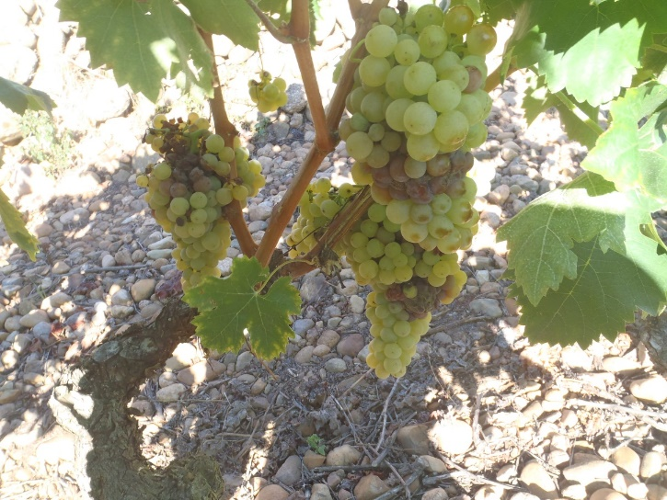
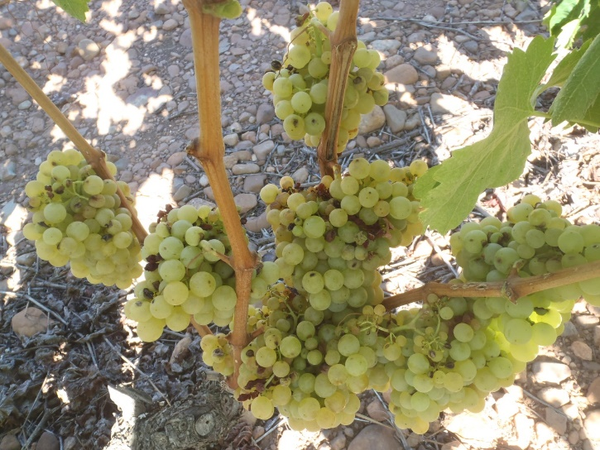
Pictures say more than a thousand graphs
Untreated control at harvest
AGROBODY™
Biofungicide Low dose
AGROBODY™
Biofungicide High dose
Confidential - Not for distribution

Slide 8
Sustainable Value Creation model
Crop protection
Global annual sales
€51bn
Fruit & Vegetables
Row Crops
Fungicides
Insecticides
€30bn
Agile, flexible, scalable AGROBODY™ Platform for novel biopesticides
Proprietary IP Position
To market biochemicals 4 years faster, significantly lower R&D cost, high regulatory certainty
Chemical
€€€€€€
Product-1
€€€
Platform
€€
2
4
6
8
10
12
Years
Research
Development
Registration (US)
Source: Phillips McDougall – October 2016
Not for distribution

Slide 9
Why BB4SME was the right match
What we needed at the start of the project
Validation of our manufacturing process
Large quantities of material for field trials!!
Access to an independent pilot facility! Since we did not have the space, time, manpower and expertise to do this inhouse
A BioBase4SME voucher was the perfect match!
Customized to our exact needs
Low barrier to entry – But high quality!
An independent but confidential perspective on our technology
Agrosavfe requested piloting services from Bio Base Europe Pilot Plant
Not for distribution
9
Notes:
9

Slide 10
Immediate results
For Agrosavfe
Successful scale up of our process to 1500L scale!
Increase in technology readiness level (TRL) from 4 to 5!
More than 2 kg of our active ingredient! (100x our inhouse production capacity)
Valuable data for further process development and optimization
Transition from research to product development
Employed 8 additional FTEs in 2018
Further growth by 10 FTEs estimated in 2019
Agrosavfe
Not for distribution
10
Notes:
10

Slide 11
Long term outcomes for stakeholders
For Europe
Increased collaboration between European SMEs and knowledge centers
The results from the BB4SME coupon are providing leverage for the application of a Horizon 2020 BBI-JU Demo project, to continue the path to commercialization
A key enabling technology platform that tackles a range of agricultural challenges
Larger investment into sufficient production capacity:
Agreements with EU-based custom manufacturing organizations
A flagship AGROBODY™ biopesticides production plant
For humanity
The transformation of crop protection from a chemical to a bio-based industry, to produce healthier food safely!
Not for distribution
11
Notes:
11

Slide 12
Safe harbor statement
This Presentation has been prepared by AGROSAVFE NV (“AGROSAVFE”), and was shared on the „SMEs rise through EU-wide cooperation: Building cross-border value chains for the bio-economy” debate in Brussels, on November 19th, 2018.
The contents of this presentation are business sensitive and, therefore, you are not authorized to disclose, totally or partially, this presentation to any third party. You acknowledge that all industrial and intellectual property rights to this presentation are and shall remain vested in AGROSAVFE. By delivering this presentation, you shall not acquire any right, title, license to use, or interest in the presentation. This presentation is delivered to you for information purposes only, and is provided "as is“ without warranties of any kind, either express or implied, including, but not limited to, warranties of fitness for a particular purpose. AGROSAVFE makes no representations about the accuracy or suitability of the information contained in this presentation. None of the information provided in this presentation takes into account your personal objectives, financial situation or needs and none of such information constitutes financial product advice. The information contained on this Presentation is not, and is not intended to be an offer of, or an invitation to purchase or subscribe for financial products. You must determine whether the information is appropriate in terms of your particular circumstances.
All of the trademarks, service marks and logos displayed in this presentation including but not limited to AGROSAVFE, AGROBODY (the “Trademark(s)”) are registered and unregistered trademarks of Agrosavfe NV or one of its affiliates. Except as expressly stated in these terms and conditions, you may not reproduce, display or otherwise use any Trademark without first obtaining Agrosavfe's written permission.
© AGROSAVFE NV. All rights reserved worldwide.
Ghent, Belgium, 2018
Not for distribution
Notes:
12

Slide 13
Emile Redant – Scientist
Mob: +32 (0) 478-690-701
Emile.Redant@agrosavfe.com
Contact
Luc Maertens – CEO
Mob: +32 (0) 479-392-297
luc.maertens@agrosavfe.com

