Slide 1
Dr Lucie Pfaltzgraff
Senior consultant @ NNFCC
Needs & challenges of SMEs in the bioeconomy in NW Europe

Slide 2
9 categories of barrier
With a total of 43 suggested barriers.
Scored from 1 to 5.

Slide 3
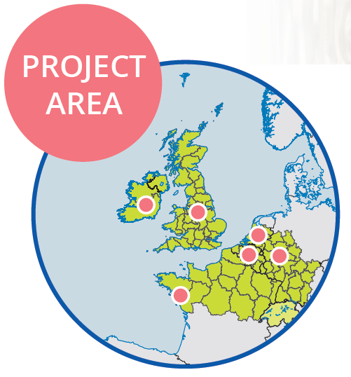
50 SMEs
Ingredients, biobased materials, biofuels, services, etc.

Slide 4
Demand-side policy
Top 3 barriers
Poor stakeholder perception
Investment risk

Slide 5
Demand-side policy barriers
These include incentives, taxation, product standards and specifications, public procurement, etc
Demand
Perception
Investment
Notes:
> ½ felt lack of market support or commercial frameworks was a large barrier
incentives, taxation, market supports, product standards and specifications, etc
difficult to compete with existing products
price & supply chains

Slide 6
SME ratings
Demand
Perception
Investment

Slide 7
“frameworks support fossil resources”
“to much focus on biofuels”
“[take example from] USDA bio-preferred programme”
SME comments
Demand
Perception
Investment

Slide 8
Difficult market
These include incentives, taxation, product standards and specifications, public procurement, etc
Demand
Perception
Investment
Notes:
> ½ felt lack of market support or commercial frameworks was a large barrier
incentives, taxation, market supports, product standards and specifications, etc
difficult to compete with existing products
price & supply chains

Slide 9
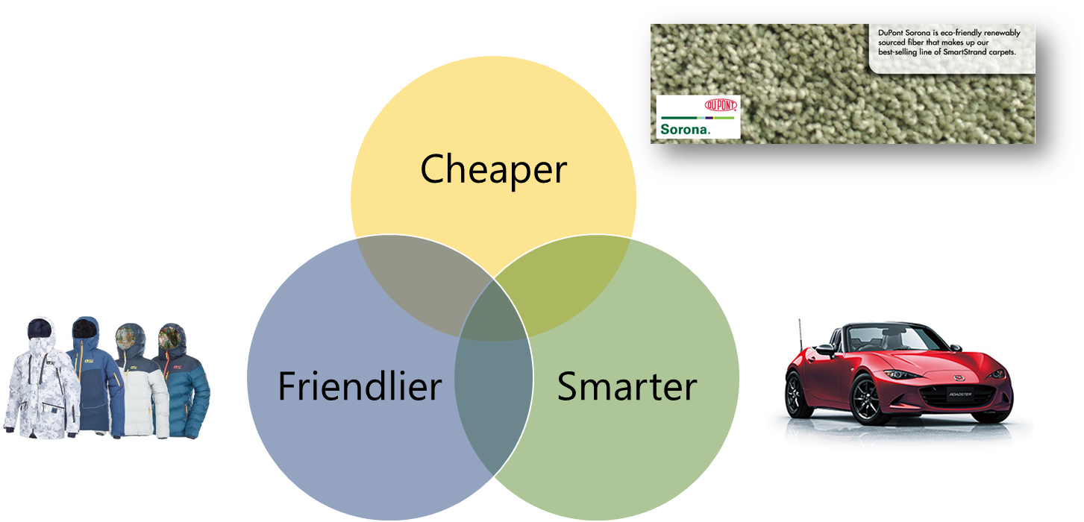
Demand-side policy barriers
Demand
Perception
Investment
Notes:
> ½ felt lack of market support or commercial frameworks was a large barrier
incentives, taxation, market supports, product standards and specifications, etc
difficult to compete with existing products
price & supply chains

Slide 10
SME rating
Demand
Perception
Investment

Slide 11
“large confusion about biobased and biodegradable plastics”
“big problem in building sector”
SME comments
Demand
Perception
Investment

Slide 12
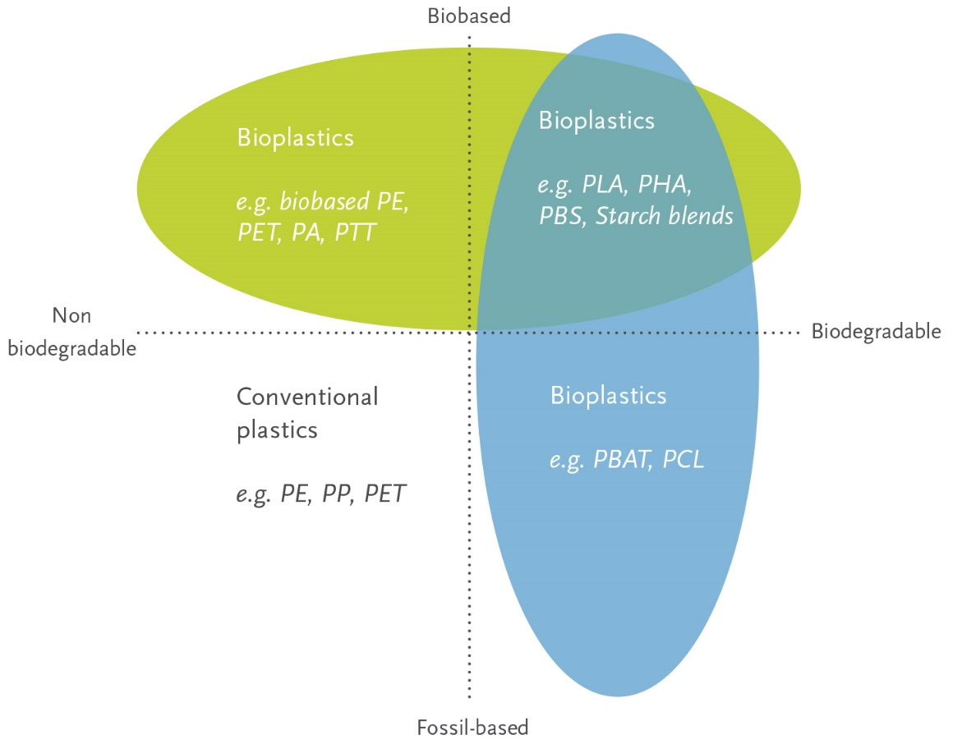
Demand
Perception
Investment

Slide 13
Investment risk
Bioeconomy technologies can take a long time to develop and bring to market, and cut across many different fields. Investors see this as confusing and risky.
Demand
Perception
Investment
Notes:
> ½ saw large barriers in:
lack of visible/tangible products
long time for return on investment
difficult to explain their business to investors
market is not always obvious
BUT many SMEs had found at least one very suitable investor!

Slide 14
SME rating
Demand
Perception
Investment

Slide 15
“traditional banks consider you as an alien”
“multinationals want drop-ins immediately”
“Great potential of our technology, but currently no tangible product”
SME comments
Demand
Perception
Investment

Slide 16
Comparison with 4 years ago
2013 | 2018
Capital requirement | Demand-side policies
Investment risk | Investment risk
Patent filing, cost and regulation | Public perception
Notes:
Things are getting better
Since 2013 there appears to be an overall improvement in the barriers for SME’s development. The mean result in 2013 meant that the identified barriers were causing considerable impacts on SME’s businesses, since then this has dropped to the low-level barrier to business with only 13 individual barriers now scoring over 3, a reduction of over a half. Twelve barriers saw a significant reduction.

Slide 17
Recommendations
Demand
Green procurement
Investment & Funding
Circular Economy Thematic Investments
Public perception
Building awareness
Demand
Perception
Investment
Notes:
Main European SME barriers now relate to
Market forces
Investor confidence
Action plan

Slide 18
Thank you!

