Slide 1
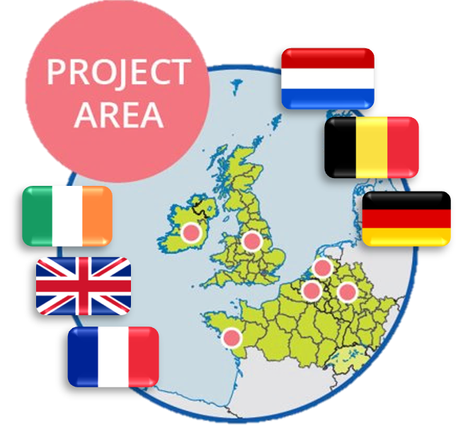
Bio-Innovation Support for Entrepreneurs throughout NWE Regions 19th Nov 2018 European Parliament, Brussels Tanja Meyer Project Coordinator
Notes:
Runs over three years with 5.8 Mio EUR

Slide 2
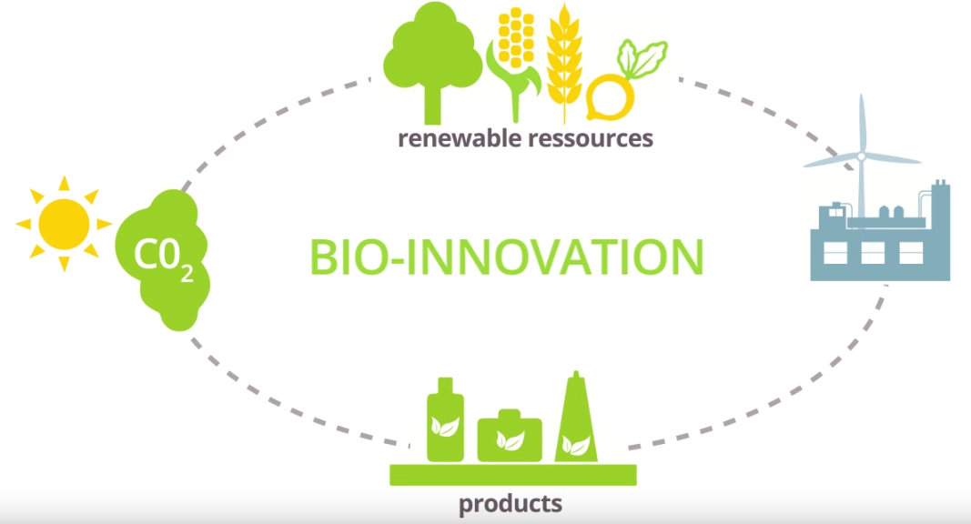
Bio Innovation Support for SMEs
Video Youtube Link

Slide 3
Build up your bioinnovation capacity!
SMEs supported by coupons: 54
Amount granted: 1,2 Mio EUR
Quick feedback to SMEs: 4 - 5 weeks
Low entry barrier: Implemented
Transnational service value: 47%
“We are currently starting a fund-raising round where these tests are a crucial part of demonstrating a higher TRL than before. This will allow us to justify a higher valuation.” Chrysalix Technologies Limited

Slide 4
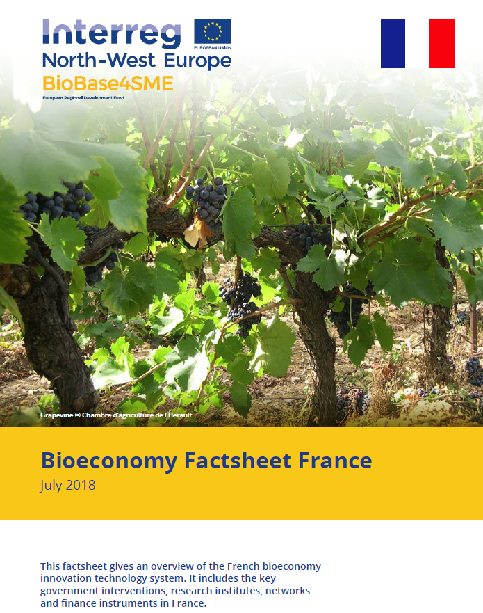
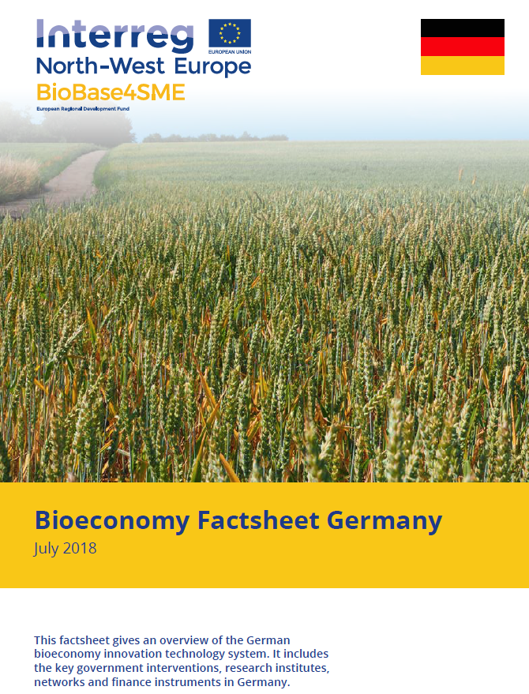
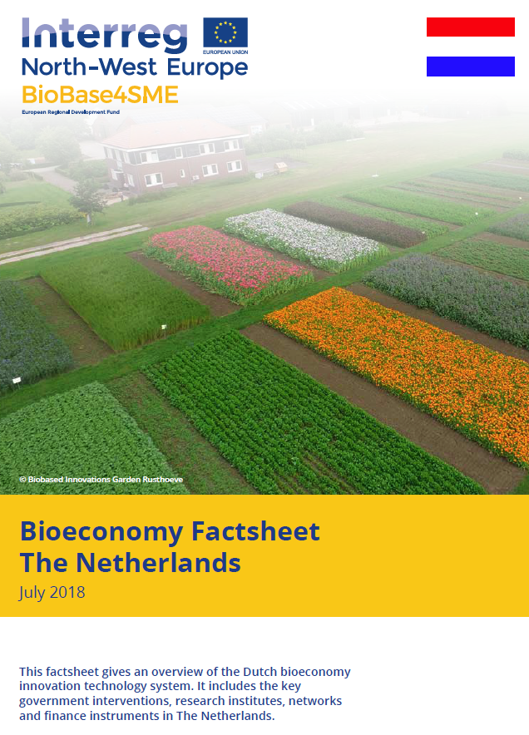
Overview factsheets for biobased SME
Notes:
Bioeconomy innovation technology system
Main stakeholder groups, Key governance institution, research institutes, networks, finance instruments
Biobased innovation is not only based on technical support for services, but also needs business support actions.

Slide 5
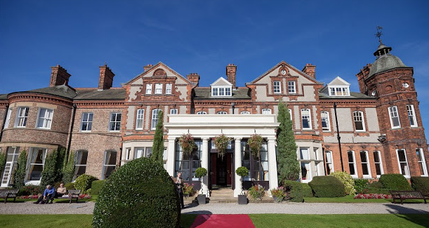
Innovation Biocamps 2017 + 2018
Intensive training in key aspects of business growth for biobased SMEs
Format: 1 week (24/7):
Master classes with experts (IP lawyer, non-exec director, investors, ...
Mentoring, peer-to-peer learning, live pitch...
Follow-up business coaching: skype coaching
review and refresh business models
→ 65% take-up after 2017 biocamp

Slide 6
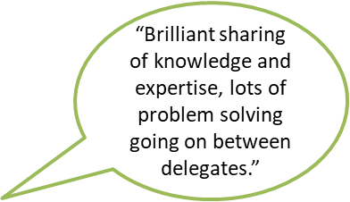
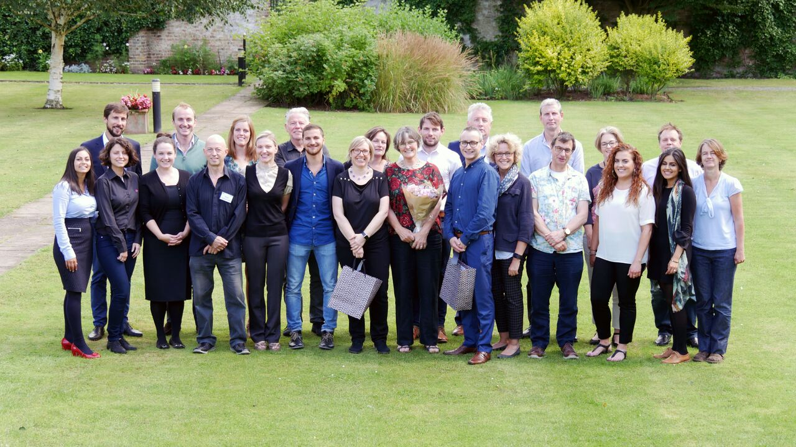
Innovation Biocamps 2017 + 2018
34 SMEs and start-ups from NWE Region
“ skills, a time to look at my business, reflection time, team building, networking and of course the people”

Slide 7
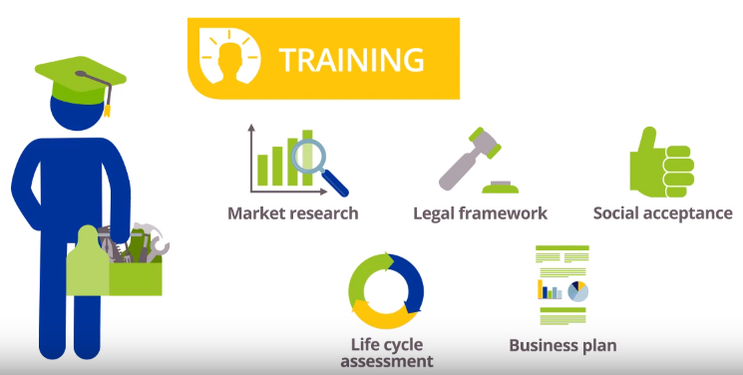
How to learn the do’s and dont’s ?
- Business Support Training
“…what was also really valuable was meeting
other entrepreneurs and sharing
our experiences and strategies.” Beta Bugs
The Collaboration Plan(t)
Biobased Business Development Day,
Natural Fibertastic 2017+2018,
Biodegradable plastic When and where?,
Start-up “The secret of getting ahead is getting started”,
Pitch Perfect and boost the European Bio-Economy
Notes:
Stakeholder gathering: - Thematical networking
IP Strategy Training, Communicating sustainability, Pitch Training, Developing dialogue with stakeholders
LCA -wanted, needed, but truly understood?,
Pitch Perfect and boost European bio-economy:
140 participants (59 SMEs),
53 pitches,
234 matchmaking meetings

Slide 8
Impact on SMEs – Q3month
, Q1year
“…use to speed up the development of our pipeline products.”
“…use the optimised enzyme production in our next manufacturing run …The process will also be used in other pipeline product work….at a sufficient development stage to now be used in our commercial production.”
must be able to be processed on an existing production line.
“…it will create jobs in the business chain.”
“...a more clear view on our business proposition...able to choose different and some how indirect stakeholders. It’s easier to complete the production chain.
“The coupon and experiments enhanced the innovation traject of my company.
It has given the company a broader picture of its opportunities in various applications. “
“…3-5 years to commercialize the process.”
“...has allowed to rank these products in order of priority, based on commercial attraction (e.g. market value, market size) and technology readiness levels.”

Slide 9
Thank you!
Notes:
Have fun and enjoy our training!

